Slide 1
DATA WAREHOUSE AND DATA MINING
NAME: JANNATUL FERDOUS NISHI
ID:19-40374-1

Slide 2
Apriori Algorithm
Association rule mining is a technique to identify underlying relations between different items. Take an example of a Grocery store where customers can buy a variety of items. Usually, there is a pattern in what the customers buy. Say, fathers may buy beer along with diapers, these transactions involve a pattern. More profit can be generated if the relationship between the items purchased in different transactions can be identified, Association rule learning is a rule-based machine learning method for discovering relations between variables in large databases. The objective is to identify strong relations discovered in datasets using some measures such as support, confidence or lift.

Slide 3
Support
Support: The Support metric says how popular and repetitive an itemset is, The number of times an item occurs in a number of transactions, statistically it is the frequency of an itemset.
Support = Occurance of Item / Total number of transactions

Slide 4
Confidence
Confidence: The Confidence metric says the strength of relation between two different item sets, how likely an item Y is purchased, when an item X is purchased, expressed as {X -> Y}, This is measured by the proportion of transactions with item X, in which item Y also appear.
Confidence = Support (X Union Y) / Support(X)

Slide 5
Lift
Lift: It is the ratio of expected confidence to observed confidence; it is the measure of confidence of Y when item X was already known (X/Y) to the confidence of Y when X item is unknown. In other words, confidence of Y with respect to X and confidence of Y independent of X.
Lift = Support (X Union Y) / Support(X) * Support(Y)

Slide 6
Apriori Algorithm
Apriori Algorithm:
The Apriori algorithm works on the assumption of anti-monotonicity of the support metric, which means,
All the subsets of a frequent itemset, must be frequent
For any infrequent itemset, all its supersets must not be frequent
Step 1: Create a frequency table of all the items that occur in all the transactions.
Step 2: We know that only those elements for which the support is greater than the set threshold support is significant. (support of an individual item > threshold support)
Step 3: The next step is to construct all the possible pairs of the selected significant items irrespective of the order. XY is same as YX.
Step 4: The next step is to find the frequency of the occurrence of such similar and related pairs of items from all transactions, and only pairs of items that are greater than the specified threshold value of support is considered.
Step 5: With step 5, it is possible to construct any number of related items with the association metrics and rules.

Slide 7
Apriori algorithm
Solution:
Support threshold=50% => 0.5*6= 3 => min _ sup=3
1. Count Of Each Item
TABLE-2
EXAMPLE OF APRIORI: SUPPORT THRESHOLD=50%, CONFIDENCE= 60%
TABLE-1
Transaction | List of items
T1 | I1,I2,I3
T2 | I2,I3,I4
T3 | I4,I5
T4 | I1,I2,I4
T5 | I1,I2,I3,I5
T6 | I1,I2,I3,I4
Item | Count
I1 | 4
I2 | 5
I3 | 4
I4 | 4
I5 | 2

Slide 8
3. Join Step: Form 2-itemset. From TABLE-1 find out the occurrences of 2-itemset.
TABLE-4
2. Prune Step: TABLE -2 shows that I5 item does not meet min _sup=3, thus it is deleted, only I1, I2, I3, I4 meet min _sup count.
TABLE-3
Item | Count
I1,I2 | 4
I1,I3 | 3
I1,I4 | 2
I2,I3 | 4
I2,I4 | 3
I3,I4 | 2
Item | Count
I1 | 4
I2 | 5
I3 | 4
I4 | 4

Slide 9
4. Prune Step: TABLE -4 shows that item set {I1, I4} and {I3, I4} does not meet min _sup, thus it is deleted.
TABLE-5
5. Join and Prune Step: Form 3-itemset. From the TABLE- 1 find out occurrences of 3-itemset. From TABLE-5, find out the 2-itemset subsets which support min _sup.
We can see for itemset {I1, I2, I3} subsets, {I1, I2}, {I1, I3}, {I2, I3} are occurring in TABLE-5 thus {I1, I2, I3} is frequent.
We can see for itemset {I1, I2, I4} subsets, {I1, I2}, {I1, I4}, {I2, I4}, {I1, I4} is not frequent, as it is not occurring in TABLE-5 thus {I1, I2, I4} is not frequent, hence it is deleted.
TABLE-6
Item | Count
I1,I2 | 4
I1,I3 | 3
I2,I3 | 4
I2,I4 | 3
Item
I1,I2,I3
I1,I2,I4
I1,I3,I4
I2,I3,I4

Slide 10
Generate Association Rules
Only {I1, I2, I3} is frequent.
6. Generate Association Rules: From the frequent itemset discovered above the association could be:
{I1, I2} => {I3}
Confidence = support {I1, I2, I3} / support {I1, I2} = (3/ 4)* 100 = 75%
{I1, I3} => {I2}
Confidence = support {I1, I2, I3} / support {I1, I3} = (3/ 3)* 100 = 100%
{I2, I3} => {I1}
Confidence = support {I1, I2, I3} / support {I2, I3} = (3/ 4)* 100 = 75%
{I1} => {I2, I3}
Confidence = support {I1, I2, I3} / support {I1} = (3/ 4)* 100 = 75%
{I2} => {I1, I3}
Confidence = support {I1, I2, I3} / support {I2 = (3/ 5)* 100 = 60%
{I3} => {I1, I2}
Confidence = support {I1, I2, I3} / support {I3} = (3/ 4)* 100 = 75%
This shows that all the above association rules are strong if minimum confidence threshold is 60%.

Slide 11
Linear Regression In Real Life
Medical Costs Analysis using a Linear Regression model
It will be presented how to simply analyze a raw data and to use regression model for the purpose of analyzing the Medical Costs Data.

Slide 12
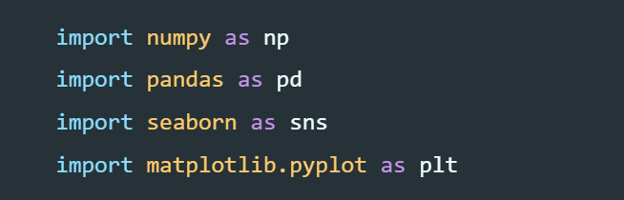
Implemantation
to load the dataset
First, let’s import required libraries for further work

Slide 13

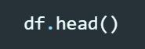
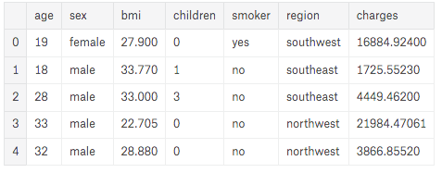
our data set
We will print the first five rows of our Data Frame to see how our data look in the table.

Slide 14
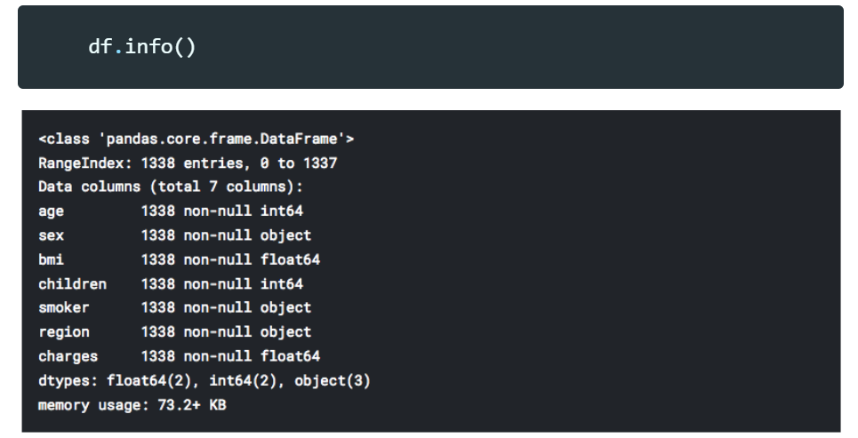
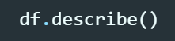
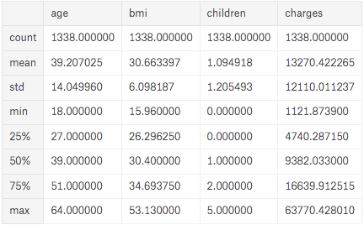
As we can see, 7 different categories are presented through the data.
function “describe” will present characteristics of all numerical categories.

Slide 15
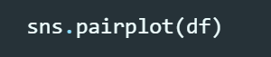
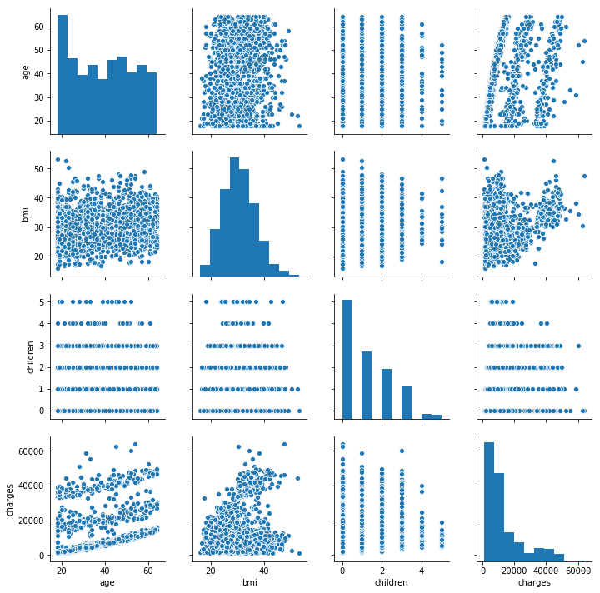
Next part is to graphically represent our numerical data. We will plot pair plot graph from the seaborn library.

Slide 16
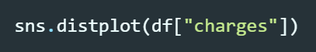
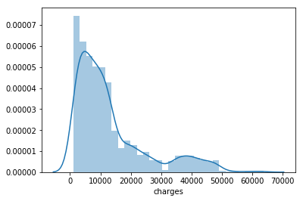
Let’s now suppose that the variable of interest is “charges”. We want to predict what would be medical costs for specific individual, based on other given information. Let’s see distribution of data for “charges”.

Slide 17
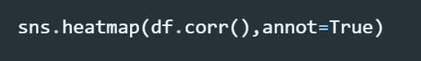
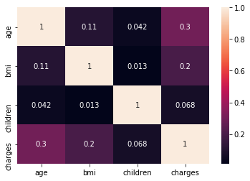
Next figure is a heatmap. It represents mutual correlation of numerical categories from our dataset

Slide 18
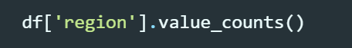
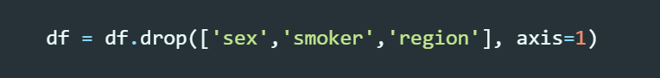
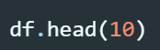
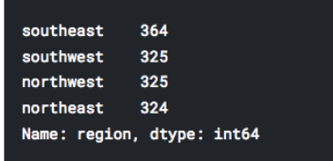
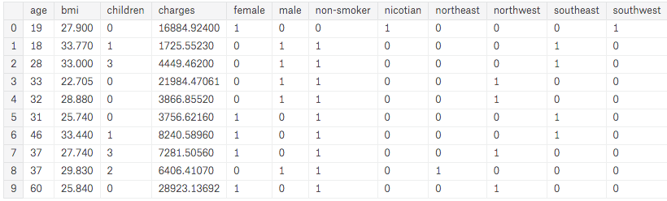
As it is said, three object categories are included
in the table below we can easily recognize our new (One hot encoding) columns.

Slide 19
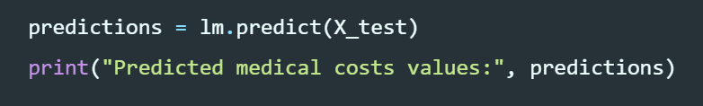
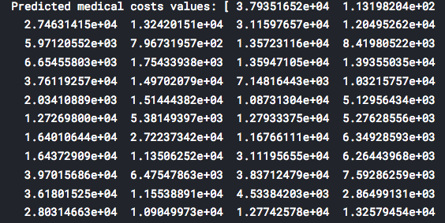
Final part of this short case study is to test the trained model for predicting a new “charges” values (by using prepared X test data which is obtained by train test split function)

Slide 20
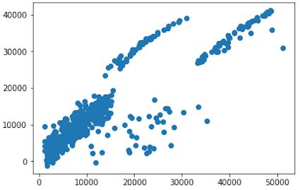
We will present graphical comparison of expected values of our analysis (y test) and predicted values (predictions) of our trained model.

Slide 21
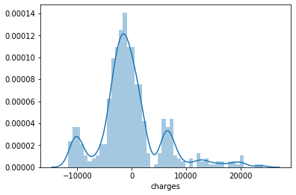
Also, let’s see an error distribution graph of our predictions.

Slide 22
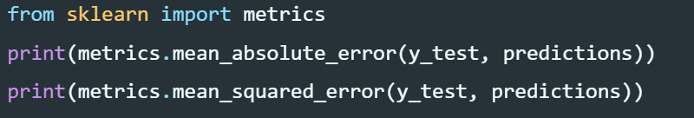
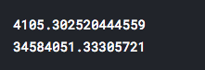
Finally, let’s calculate and print mean absolute error (MAE) and mean squared error (MSE) for our predictions. These measures will represent quality parameters of our model (achieved prediction accuracy)

Slide 23
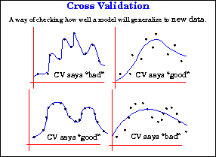
Cross Validation
Cross validation is a model evaluation method that is better than residuals. The problem with residual evaluations is that they do not give an indication of how well the learner will do when it is asked to make new predictions for data it has not already seen. One way to overcome this problem is to not use the entire data set when training a learner. Some of the data is removed before training begins. Then when training is done, the data that was removed can be used to test the performance of the learned model on "new'' data. This is the basic idea for a whole class of model evaluation methods called cross validation.

Slide 24
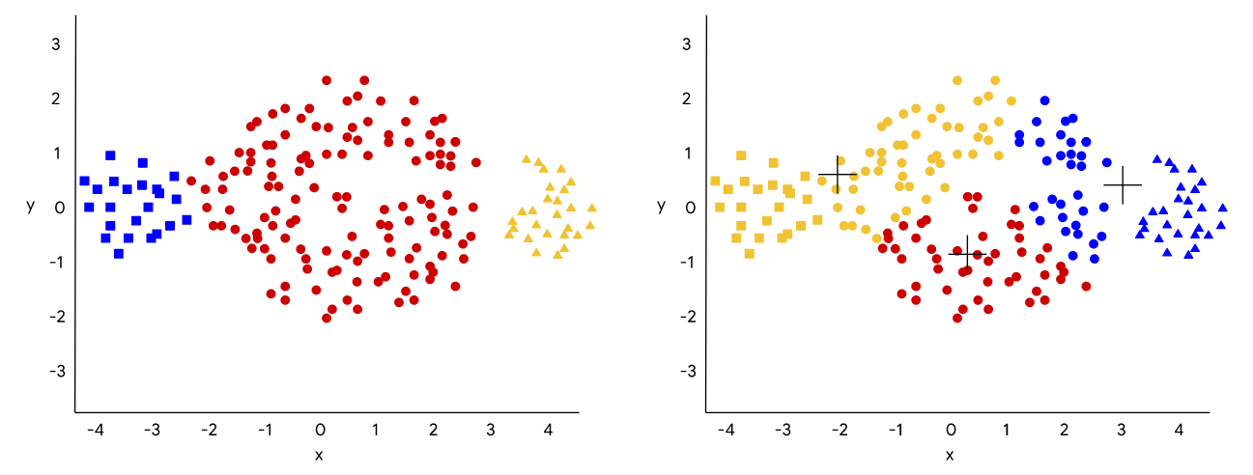
K-means
K-means is a simple iterative clustering algorithm. Starting with randomly chosen KK centroids, the algorithm proceeds to update the centroids and their clusters to equilibrium while minimizing the total within cluster variance. It is primarily used in scenarios with real-valued features because it relies on the Euclidean distance to discover cluster centroids.
Advantages of k-means
Relatively simple to implement.
Scales to large data sets.
Guarantees convergence.
Can warm-start the positions of centroids.
Easily adapts to new examples.
Generalizes to clusters of different shapes and sizes, such as elliptical clusters.

Slide 25
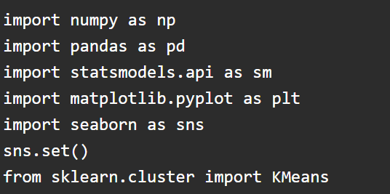
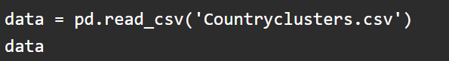
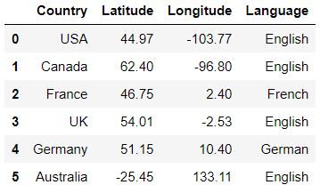
Python Implementation
Importing relevant libraries
Loading the Data

Slide 26
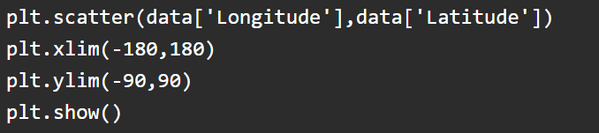
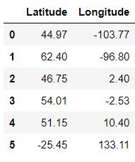
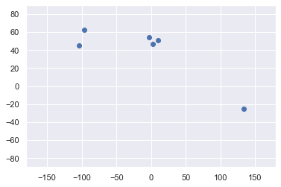
Plotting the data Selecting the feature

Slide 27

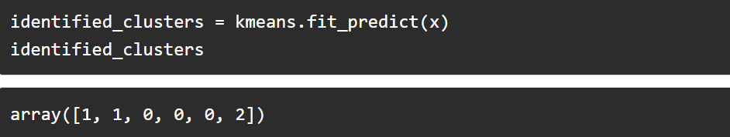
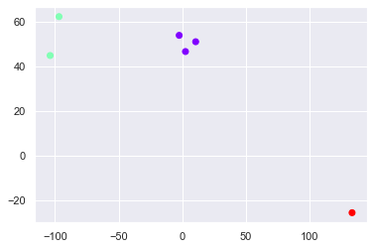
Clustering Results

Slide 28
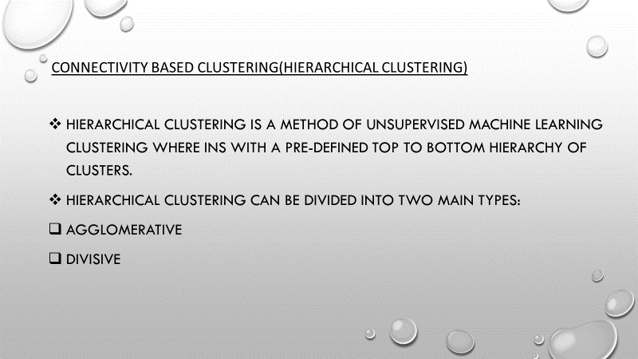

Slide 29
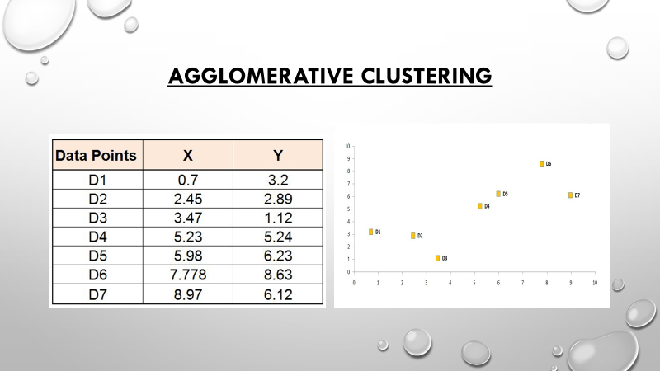

Slide 30
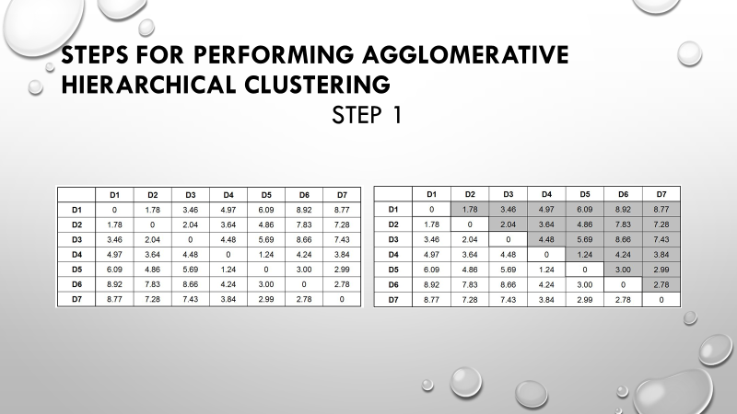

Slide 31
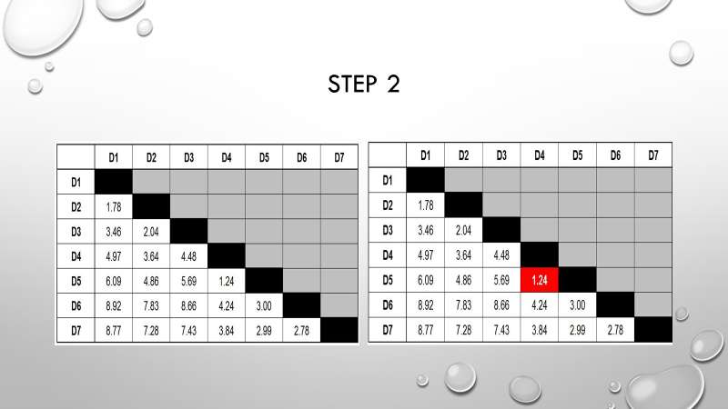

Slide 32
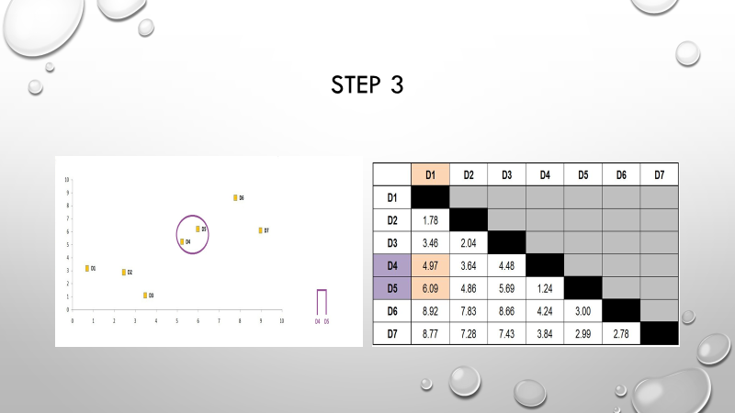

Slide 33
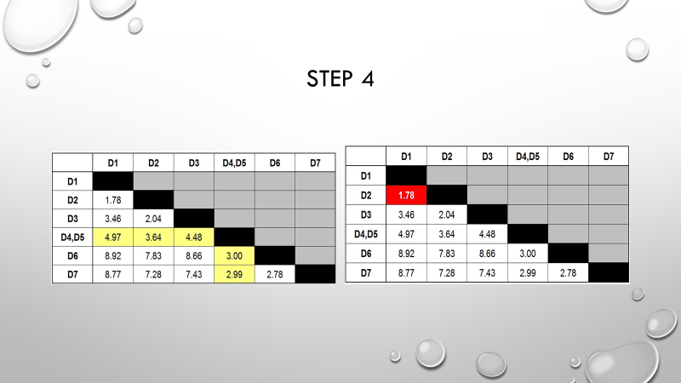

Slide 34
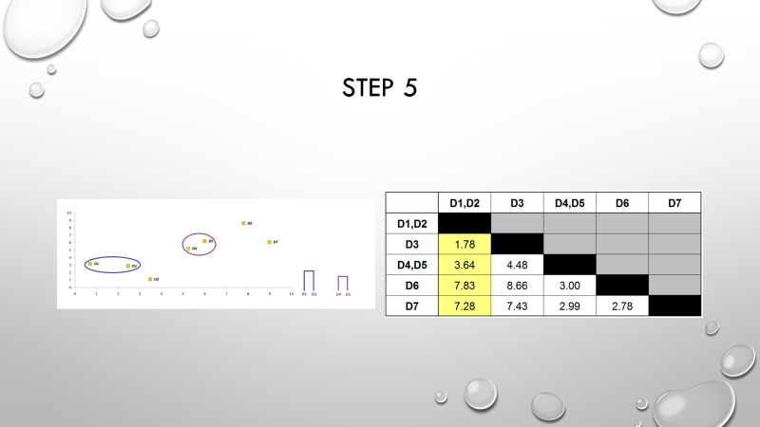

Slide 35
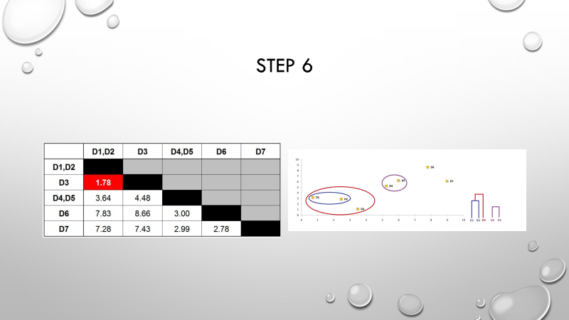

Slide 36
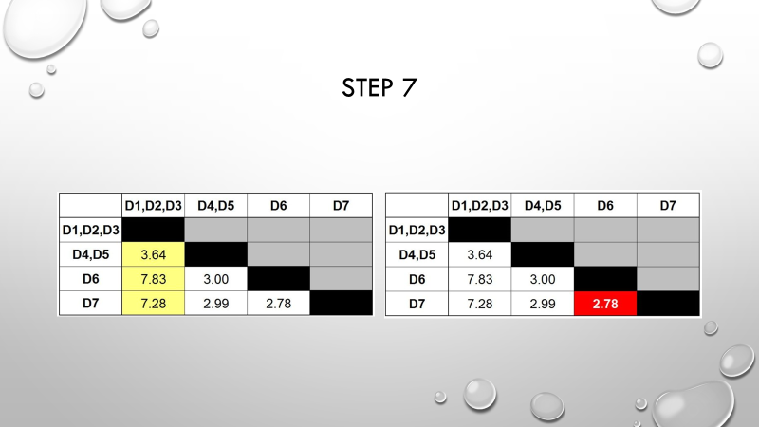

Slide 37
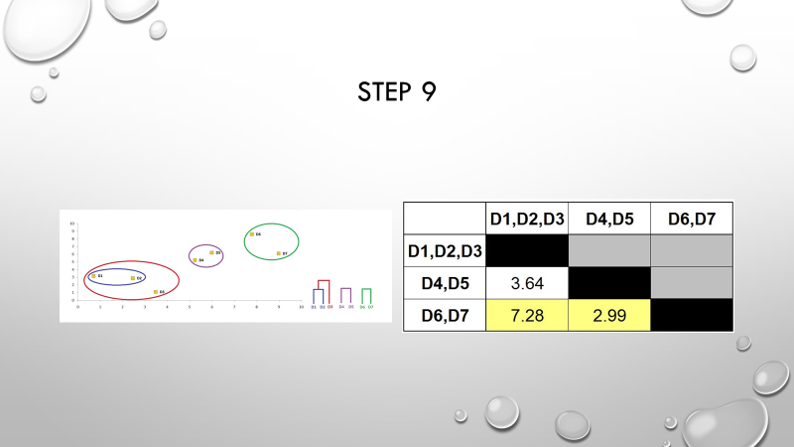

Slide 38
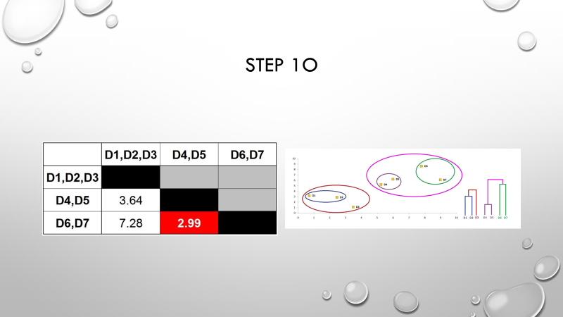

Slide 39
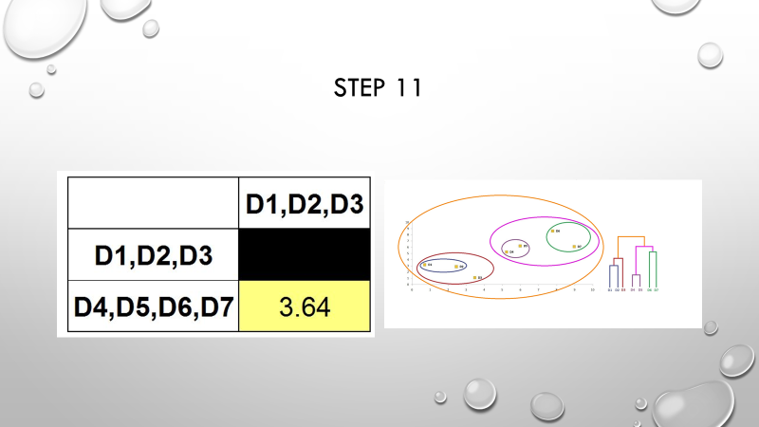

Slide 40
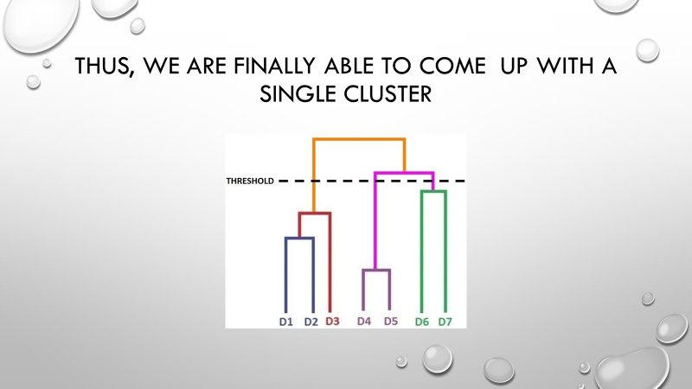

Slide 41
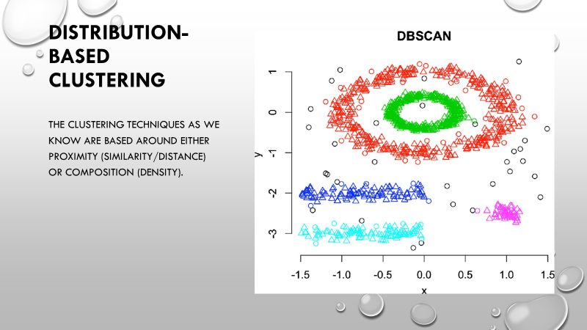

Slide 42
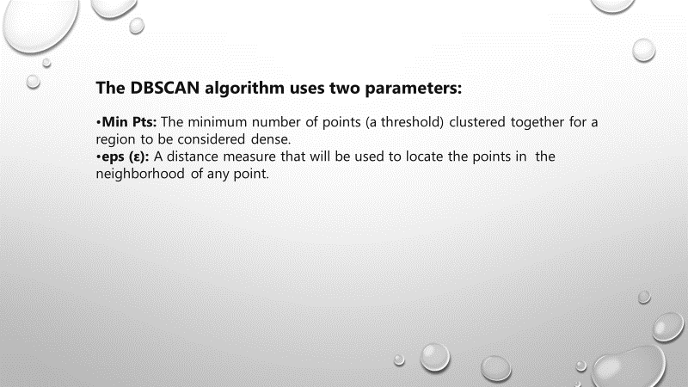

Slide 43
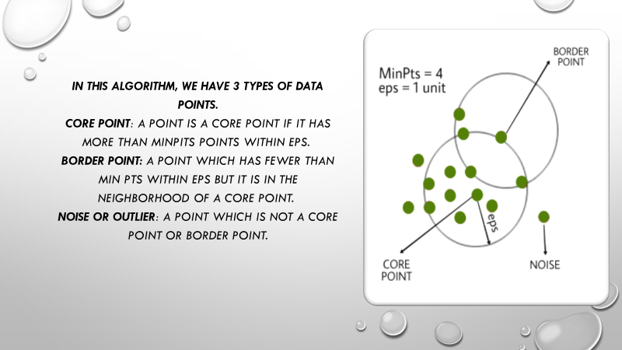

Slide 44
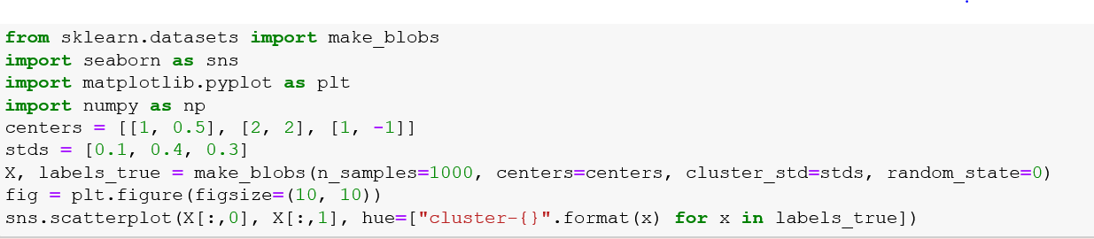

DBSCAN CLUSTRING Example
Here, I have created 3 blobs of data. We can see the visualization of these data blobs as illustrated in Figure 1. For this example, I intentionally created 3 clusters with different densities to make clustering harder.

Slide 45

DBSCAN and its Parameters
DBSCAN and its Parameters
DBSCAN has a few parameters and out of them, two are crucial. First is the eps parameter, and the other one is min_points (min_samples). Latter refers to the number of neighbouring points required for a point to be considered as a dense region, or a valid cluster. Usually, we set this to a value that makes sense for the dataset and the number of dimensions present in the data. This will determine the number of outliers identified. However, this parameter is not as crucial as eps.
Epsilon parameter of DBSCAN
The most important parameter of DBSCAN can be identified as eps. It is the furthest distance at which a point will pick its neighbours. Therefore, intuitively this will decide how many neighbours a point will discover. Although for the min_points/min_samples we can give a default value, we cannot do so for eps. This will depend on the distribution of the data itself. Let us do DBSCAN with some guessed values for our dataset. The code and visualisation (in Figure 2) would be as shown below.

Slide 46


Slide 47

Tuning EPS parameter
We can clearly see from our last figure, two clusters have been merged together. This is bad. Such situations can reduce recall in a real-world clustering application. Let’s try to vary eps and cluster again. The code and visualization ) would look like below.

Slide 48


Slide 49
A Systematic Method for Tuning the eps Value
Since the eps figure is proportional to the expected number of neighbours discovered, we can use the nearest neighbours to reach a fair estimation for eps. Let us compute the nearest neighbours.

Slide 50


Slide 51


Knee Locator to Detect Elbow Point

Slide 52

We can see that the detected knee point by this method is at distance 0.178. Now we can use this value as our eps to see how our new clustering would look like.

Slide 53

Cross-Validation Machine Learning Model Performance
Cross validation may be any of various model validation techniques that are used to assess how well a predictive model will generalize to an independent set of data that the model has not seen before. Hence, it is typically employed in situations where we predict something and we want to gain a rough estimate of how well our predictive model will perform in practice.

Slide 54
POPULAR CROSS VALIDATION TECHNIQUES
Hold-Out Based Cross Validation
K-Fold Cross Validation
Leave-One-Out Cross Validation
Group K-fold Cross Validation

Slide 55

K-Fold Cross Validation
In k-fold cross-validation, the original sample is randomly partitioned into k equal sized groups. From the k groups, one group would be removed as a hold-out set and the remaining groups would be the training data. The predictive model is then fit on the training data and evaluated on the hold-out set. This procedure is k times so that all groups have served exactly once as the hold-out set.

Slide 56

Stratified K-Fold
we have covered till now are relatively effective in many scenarios, although misleading results (and potentially overall failure) can arise when the target data has imbalanced labels — I’ve been careful not to only mention this as a problem for classification task because we can adjust a regression task in some ways for us to be able to perform stratified k-fold for validation.

Slide 57

Leave-One-Out Cross Validation
Leave-one-out Cross validation may be thought of as a special case of k-fold cross validation where k = n and n is the number of samples within the original dataset. In other words, the data will be trained on n - 1 samples and will be used to predict the sample that was left out and this would be repeated n times so that each sample serves as the left out sample.

Slide 58
feature selection
Feature selection is the process of reducing the number of input variables when developing a predictive model.
It is desirable to reduce the number of input variables to both reduce the computational cost of modeling and, in some cases, to improve the performance of the model.

Slide 59

Statistics for Filter-Based Feature Selection Methods
Common data types include numerical (such as height) and categorical (such as a label), although each may be further subdivided such as integer and floating point for numerical variables, and boolean, ordinal, or nominal for categorical variables.Common input variable data types:
Numerical Variables
Integer Variables.
Floating Point Variables.
Categorical Variables.
Boolean Variables (dichotomous).
Ordinal Variables.
Nominal Variables.

Slide 60

Information Gain
Information gain calculates the reduction in entropy from the transformation of a dataset. It can be used for feature selection by evaluating the Information gain of each variable in the context of the target variable.

Slide 61

Chi-square Test
The Chi-square test is used for categorical features in a dataset. We calculate Chi-square between each feature and the target and select the desired number of features with the best Chi-square scores.

Slide 62

Correlation Coefficient
Correlation is a measure of the linear relationship of 2 or more variables. Through correlation, we can predict one variable from the other. The logic behind using correlation for feature selection is that the good variables are highly correlated with the target.

Slide 63

Variance Threshold
The variance threshold is a simple baseline approach to feature selection. It removes all features which variance doesn’t meet some threshold. By default, it removes all zero-variance features, i.e., features that have the same value in all samples. We assume that features with a higher variance may contain more useful information , but note that we are not taking the relationship between feature variables or feature and target variables into account, which is one of the drawbacks of filter methods.

Slide 64

Mean Absolute Difference (MAD)
The mean absolute difference (MAD) computes the absolute difference from the mean value. The main difference between the variance and MAD measures is the absence of the square in the latter. The MAD, like the variance, is also a scale variant. This means that higher the MAD, higher the discriminatory power.

Slide 65

Dispersion ratio
Another measure of dispersion applies the arithmetic mean (AM) and the geometric mean (GM). For a given (positive) feature X_{i} on n patterns, the AM and GM are given by respectively; since AM_{i} ≥ GM_{i}, with equality holding if and only if X_{i1} = X_{i2} = …. = X_{in}, then the ratio
can be used as a dispersion measure. Higher dispersion implies a higher value of Ri, thus a more relevant feature. Conversely, when all the feature samples have (roughly) the same value, Ri is close to 1, indicating a low relevance feature.

Slide 66

Random Forest Importance
Random Forests is a kind of a Bagging Algorithm that aggregates a specified number of decision trees. The tree-based strategies used by random forests naturally rank by how well they improve the purity of the node, or in other words a decrease in the impurity over all trees. Nodes with the greatest decrease in impurity happen at the start of the trees, while notes with the least decrease in impurity occur at the end of trees. Thus, by pruning trees below a particular node, we can create a subset of the most important features.

Slide 67
Conclusion
We have discussed a few techniques for feature selection. We have on purpose left the feature extraction techniques like Principal Component Analysis, Singular Value Decomposition, Linear Discriminant Analysis, etc. These methods help to reduce the dimensionality of the data or reduce the number of variables while preserving the variance of the data.

